Slide 1

API Documentation
End Points
Resources
HTTP Methods
Data types

Slide 2
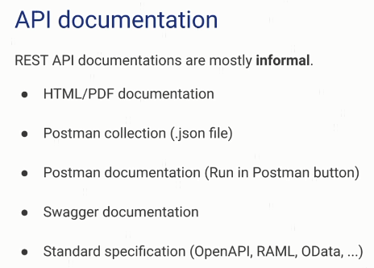
API Documentation

Slide 3
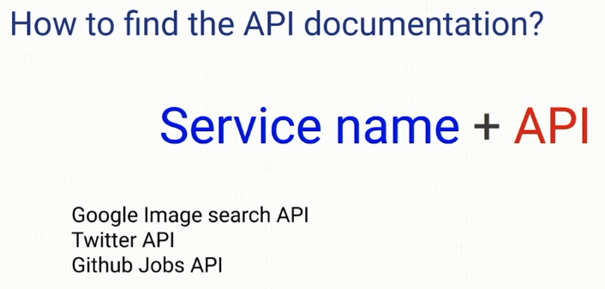
API Documentation

Slide 4
API Documentation
https://jobs.github.com/api
https://petstore.swagger.io/
https://documenter.getpostman.com/view/10808728/SzS8rjbc

